Slide 1





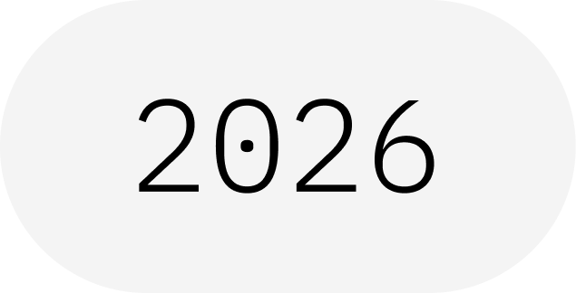
Sampler Primitive
From Circuits to Bitstrings
IBM Quantum School
Saad Ejaz • Guest Speaker
Qiskit Fall Fest 2026 at University of Engineering & Technology Lahore,Narowal Campus

Slide 2
01
SPEAKER INTRODUCTION
Saad Ejaz
Guest Speaker
Computer Engineering student and IBM Quantum School tutor, introducing the Sampler primitive and how it turns quantum circuits into measured results.
IBM Quantum School
Qiskit Fall Fest 2026 at University of Engineering & Technology Lahore,Narowal Campus

Slide 3
02
TABLE OF CONTENTS
01
What Is a Primitive?
02
The Sampler Workflow
03
Inputs: The PUB
04
Outputs: Bitstrings & Counts
05
Basic Qiskit Implementation
06
Takeaways & Resources
Qiskit Fall Fest 2026 at University of Engineering & Technology Lahore,Narowal Campus

Slide 4

WHAT IS A QISKIT FALL FEST?
03
A beginner-friendly session on the Sampler primitive: how to run a circuit and read back the bitstrings it measures.
Qiskit Fall Fest 2026 at University of Engineering & Technology Lahore,Narowal Campus

Slide 5
04
INTRODUCTION
01
Qiskit Fall Fest 2026 at University of Engineering & Technology Lahore,Narowal Campus

Slide 6
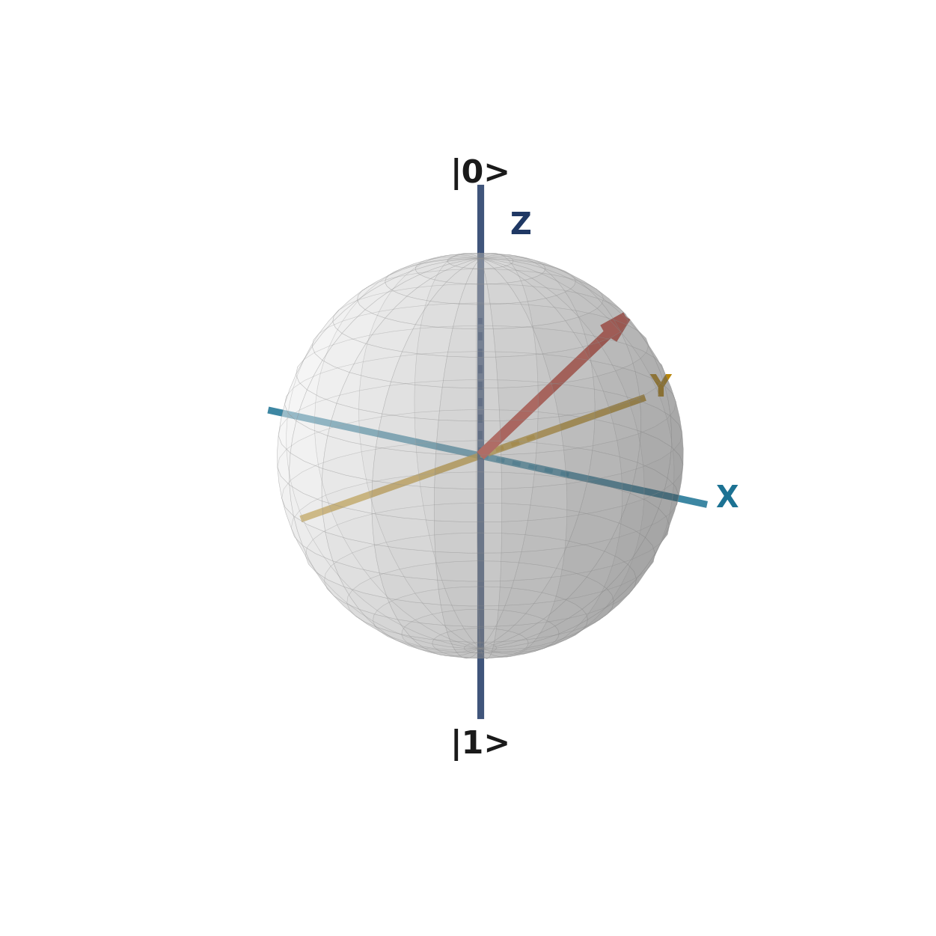
05
WHAT IS A PRIMITIVE?
A primitive is the standard way to run circuits.
CIRCUIT + SHOTS
Qiskit Runtime offers two primitives. Each one takes circuits, runs them, and returns results in a consistent format.
The Sampler returns the bitstrings your circuit measured.
SAMPLER
BITSTRINGS
Qiskit Fall Fest 2026 at University of Engineering & Technology Lahore,Narowal Campus

Slide 7
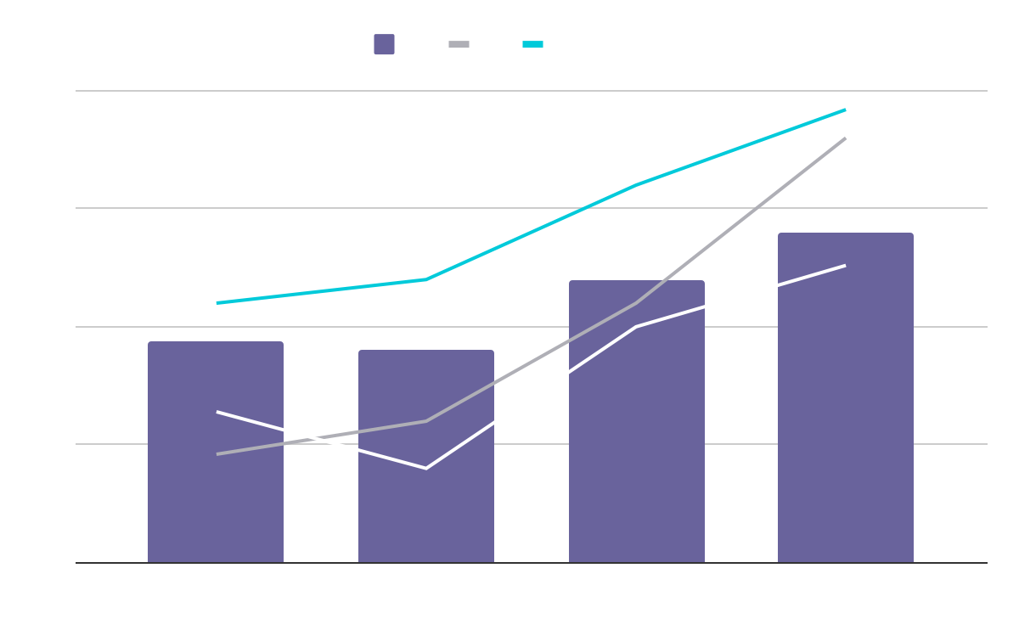
THE SAMPLER WORKFLOW
01
02
03
04
Build
Transpile
Run
Read
Create a circuit and add measurements.
Convert it to match the chosen device.
Send it to the Sampler with a shot count.
Get bitstrings and counts from the result.
The Sampler returns samples: what was actually measured.
Qiskit Fall Fest 2026 at University of Engineering & Technology Lahore,Narowal Campus

Slide 8
07
INPUTS & OUTPUTS
02
Qiskit Fall Fest 2026 at University of Engineering & Technology Lahore,Narowal Campus

Slide 9
08
INPUT: THE PUB
Each job is a list of PUBs. A PUB bundles a circuit with its run settings.
CIRCUIT
PARAMETERS
SHOTS
Must measure
Optional values
Repetitions
Add measurements, or there is nothing to sample.
Bind values to a parametrized circuit to sweep many settings in one job.
How many times to run the circuit. Set it per run or as a default.
Qiskit Fall Fest 2026 at University of Engineering & Technology Lahore,Narowal Campus

Slide 10
09
OUTPUT: BITSTRINGS & COUNTS
RAW SAMPLES
COUNTS
Each shot gives one bitstring, such as 00 or 11.
Count how often each bitstring appeared to estimate its probability.
KEY POINT
Results are stored per classical register. The default register from measure_all() is named meas.
Qiskit Fall Fest 2026 at University of Engineering & Technology Lahore,Narowal Campus

Slide 11
10
SAMPLER OR ESTIMATOR?
Choose by the question you ask.
SAMPLER
Use the Sampler to see the full distribution of outcomes.
Use the Estimator to get expectation values of observables.
Returns bitstrings and their counts.
ESTIMATOR
Returns expectation values of the observables you define.
Qiskit Fall Fest 2026 at University of Engineering & Technology Lahore,Narowal Campus

Slide 12
11
WHEN TO USE THE SAMPLER
OUTPUT DISTRIBUTIONS
SEARCH PROBLEMS
See how likely each measurement outcome is.
Algorithms like Grover search read their answer from measured bitstrings.
PARAMETER SWEEPS
CLASSICAL ANALYSIS
Run many parameter settings in a single job.
Feed the counts into your own code for further analysis.
Qiskit Fall Fest 2026 at University of Engineering & Technology Lahore,Narowal Campus

Slide 13
12
IMPLEMENTATION
03
Qiskit Fall Fest 2026 at University of Engineering & Technology Lahore,Narowal Campus

Slide 14
13
BASIC QISKIT IMPLEMENTATION
EXAMPLE: BELL STATE
# 1. Build a Bell circuit with measurements
qc = QuantumCircuit(2)
qc.h(0); qc.cx(0, 1); qc.measure_all()
# 2. Transpile for the backend
backend = QiskitRuntimeService().least_busy(simulator=False)
pm = generate_preset_pass_manager(
optimization_level=3, backend=backend)
isa_qc = pm.run(qc)
# 3. Run with the Sampler primitive
sampler = SamplerV2(mode=backend)
job = sampler.run([isa_qc], shots=1024)
# 4. Read the counts from the "meas" register
print(job.result()[0].data.meas.get_counts())
The result holds bitstring counts, mostly 00 and 11. Imports are omitted for space.
1 Build
2 Transpile
3 Run
4 Read
Qiskit Fall Fest 2026 at University of Engineering & Technology Lahore,Narowal Campus

Slide 15
14
RESOURCES
IBM QUANTUM LEARNING
Qiskit Runtime primitives and Sampler examples.
QISKIT DOCUMENTATION
SamplerV2 reference and primitive inputs and outputs (PUBs).
KEY TAKEAWAY
The Sampler returns measured bitstrings and counts.
Qiskit Fall Fest 2026 at University of Engineering & Technology Lahore,Narowal Campus

Slide 16
THANKS!
DO YOU HAVE ANY QUESTIONS?
15
Saad Ejaz • Guest Speaker
IBM Quantum School
Qiskit Fall Fest 2026 at University of Engineering & Technology Lahore,Narowal Campus

